Slide 1
Tx Driver - VM
1 Gbps
Muhammad Aldacher

Slide 2
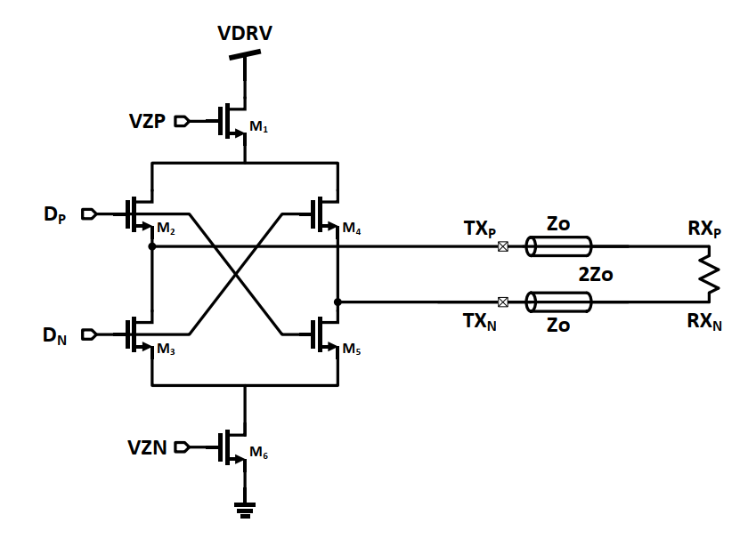

Voltage-Mode Driver (VM)
$$V_{{Swing}_{(pk2pk)}}$$
Higher Vswing means:
Higher SNDR, but Higher Power also

Slide 3
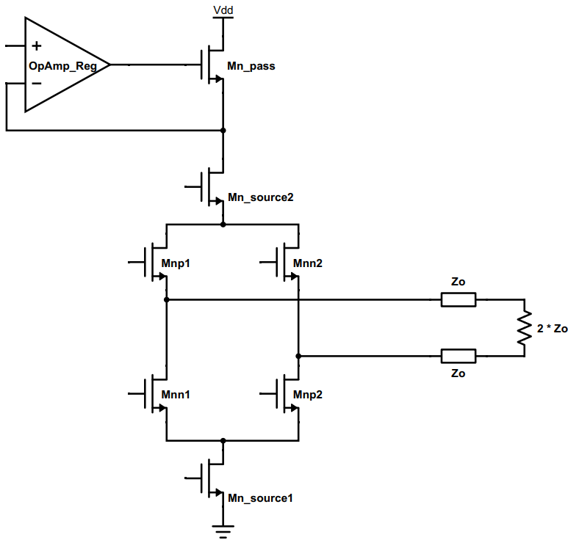


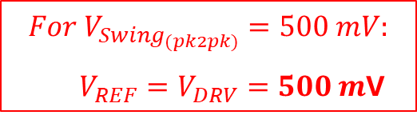


1) Without Replica
$$V_{{Swing}_{(pk2pk)}}=V_{DRV}=V_{REF}$$
$$V_{REF}$$
$$Regulator$$
$$For V_{{Swing}_{(pk2pk)}}=500 mV:$$
$V_{REF}=V_{DRV}=500 m$V
$$V_{DRV}$$
Vb2
Vin+
Device Sizing:
Input devices (Mnp1,2 & Mnn1,2) act as switches, so we should increase W (reducing RON) to improve headroom.
Bias devices (Mn_source1,2) should have their W & gate voltages Vb1,2 adjusted so that the output voltages would be at ¾ VDRV & ¼ VDRV.
Vout+
Vout–
Vin–
Vb2
Mnp1,2 = Mnn1,2 : L = LMIN , m=100x
Mn_source1,2 : L = LMIN , m=200x

Slide 4
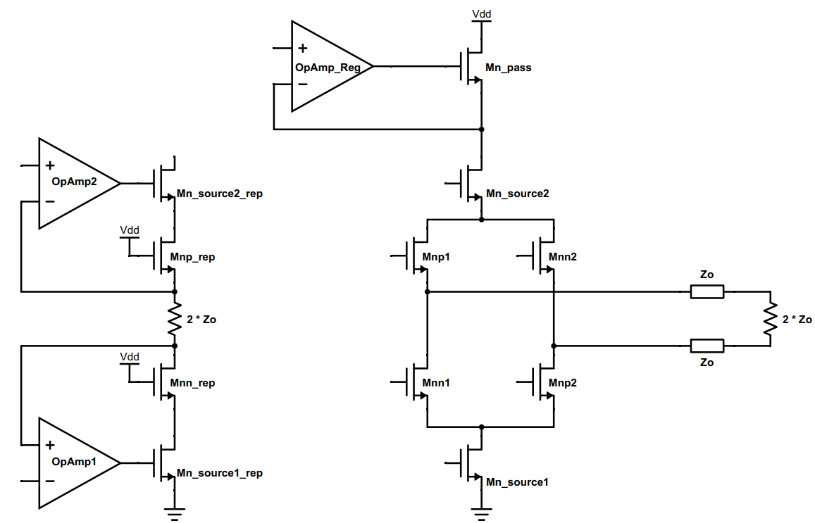



2) With Replica
$$V_{{Swing}_{(pk2pk)}}=V_{DRV}=V_{REF}$$
$$V_{REF}$$
$$Regulator$$
$${\frac{3}{4}V}_{DRV}$$
$$V_{DRV}$$
$$V_{DRV}$$
Vb2
Vin+
Vout+
Vout–
Vin–
For the L of the Bias devices (Mn_source1,2), We can use minimum L, because the feedback loops in the replica branch will adjust the currents to give the correct output swing anyway.
$${\frac{1}{4}V}_{DRV}$$
Vb2
Mnp1,2 = Mnn1,2 = Mnp1,2_rep = Mnn1,2_rep : L = LMIN , m=100x
Mn_source1,2 = Mn_source1,2_rep : L = LMIN , m=200x

Slide 5
Testbenchs & Setups
VDD = 1V
Data-Rate = 1 Gb/s
VSWING = 0.5V (pk2pk)

Slide 6
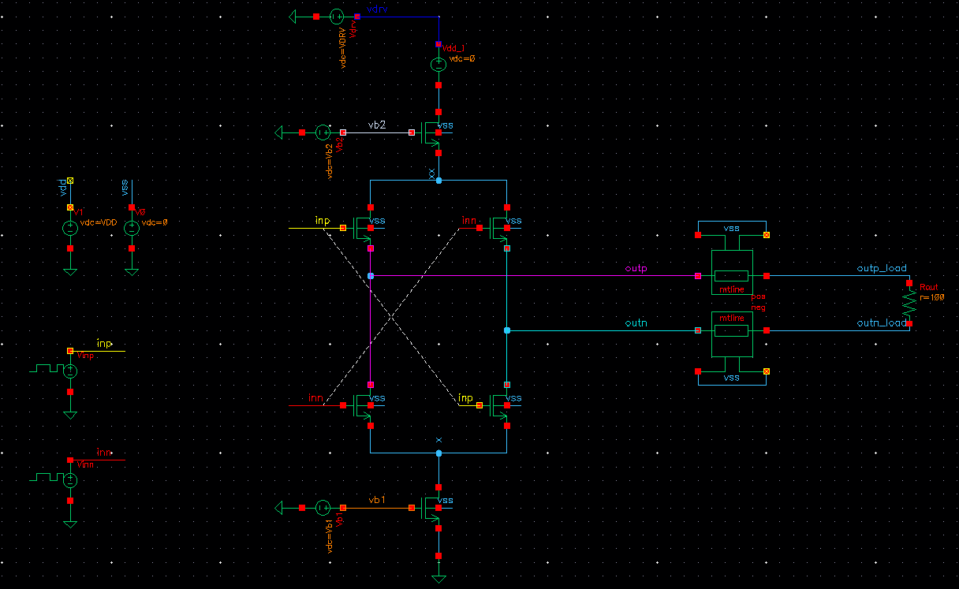
Testbench A) Without Replica
VDRV=0.5V
VDD=1V
LIB: analogLib
CELL: vprbs
Zero value: 0 V / 1 V
One value: 1 V / 0 V
Bit period: 1 ns
Rise/Fall times: 20 ps
Edge type: linear
Trigger: Internal
LFSR Mode: PN32
To find the bias voltages vb1 & vb2, You can do a DC-sweep with inp=1 & inn=0, & choose vb1 & vb2 that would give outputs of ¾ VDRV & ¼ VDRV.

Slide 7
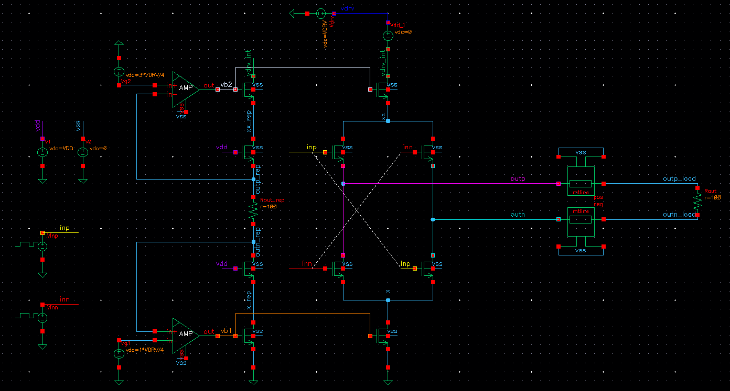
Testbench B) With Replica
VDRV=0.5V
0.75 * VDRV
=0.375V
VDD=1V
0.25 * VDRV
=0.125V

Slide 8

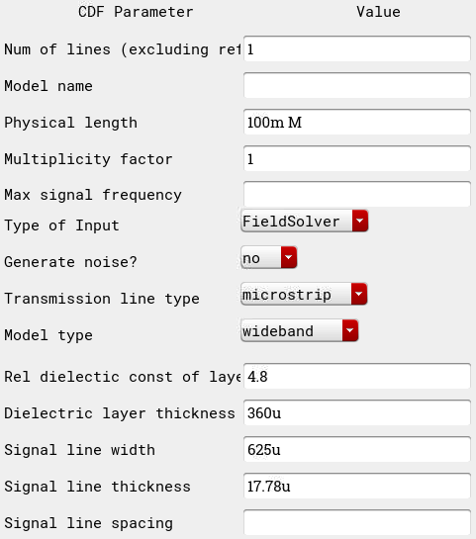
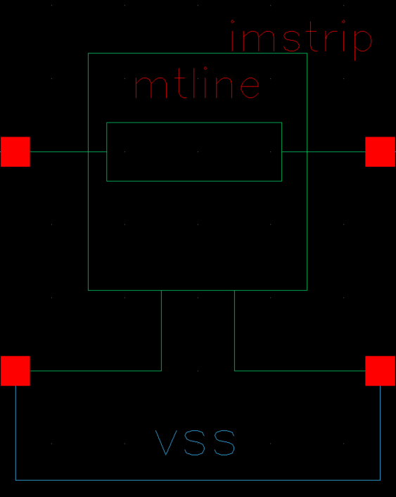
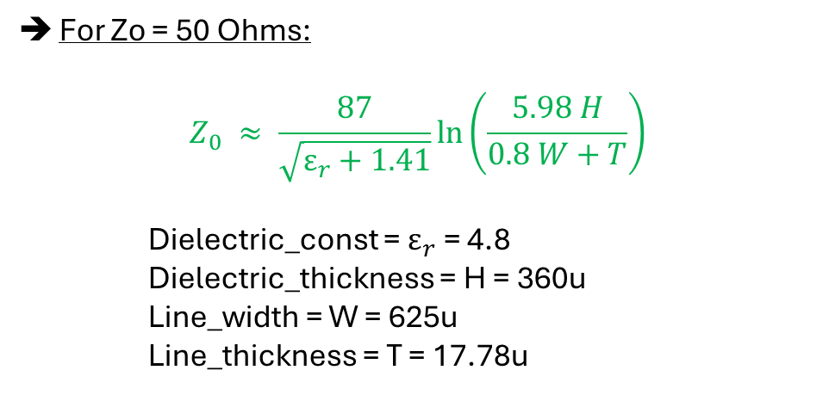
Channel Settings (mtline)
For Zo = 50 Ohms:
$$Z_{0} ≈ \frac{87}{\sqrt{ε_{r}+1.41}}\ln\left(\frac{5.98 H}{0.8 W+T}\right)$$
Dielectric_const = $ε_{r}$= 4.8
Dielectric_thickness = H = 360u
Line_width = W = 625u
Line_thickness = T = 17.78u

Slide 9
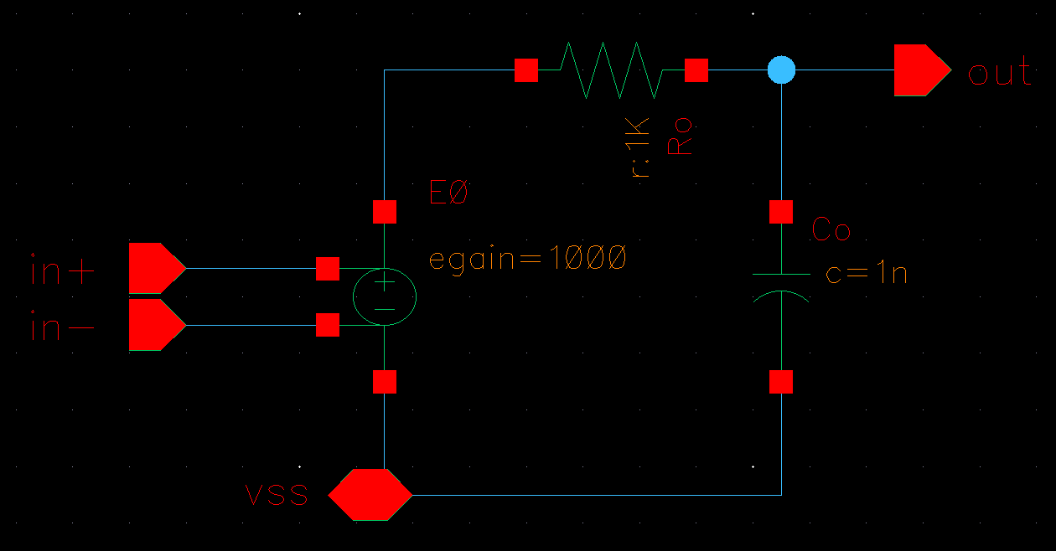
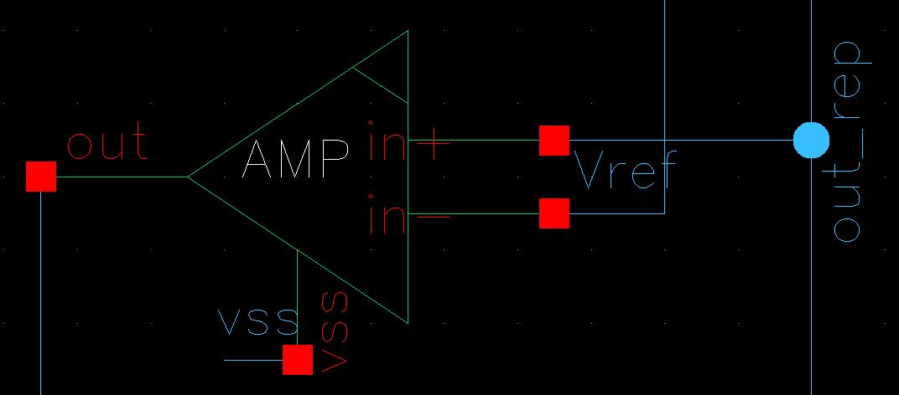

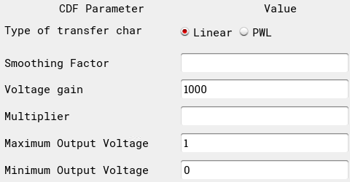
Ideal OpAmp
vcvs
(analoglib)

Slide 10
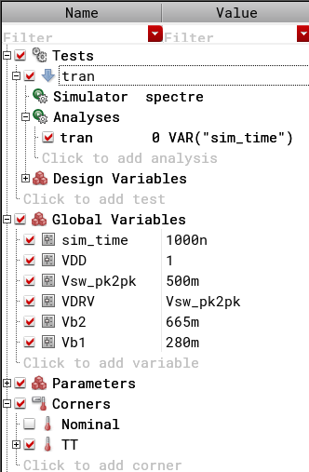
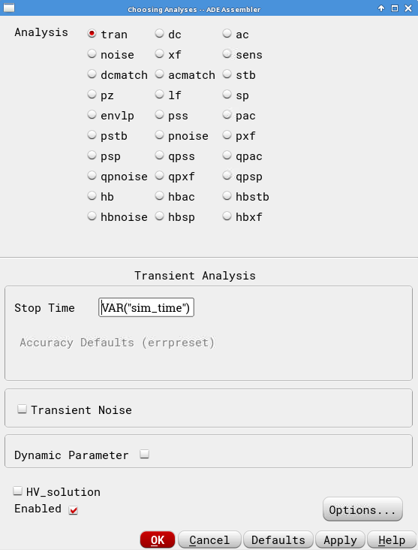
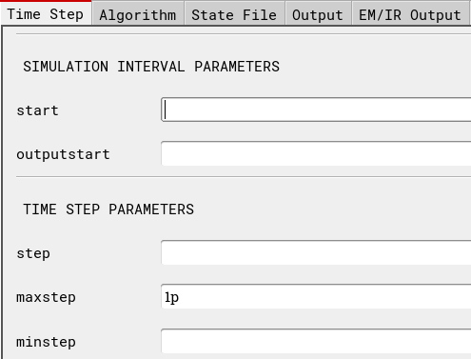
Simulation Setup

Slide 11
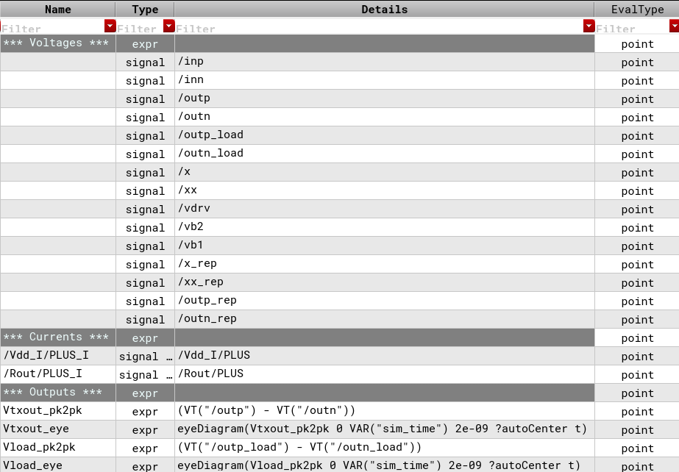
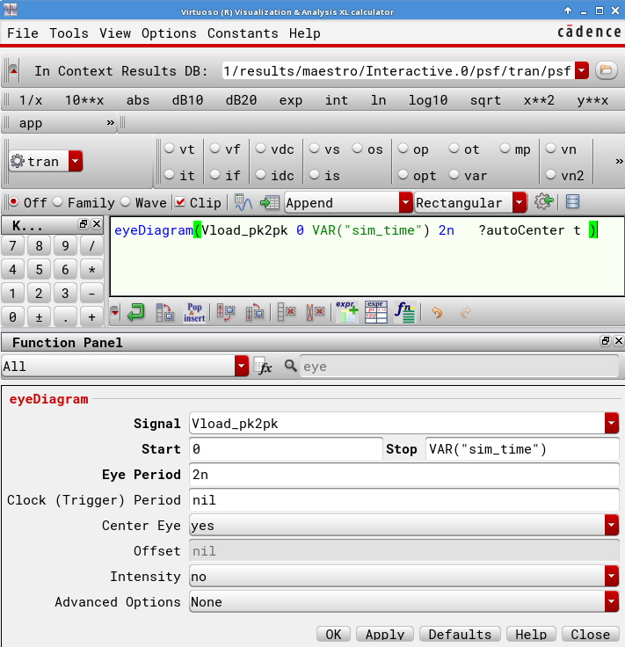
Measurements
2*UI
eyeDiagram(VT("/outp_load")-VT("/outn_load") 0 VAR(“sim_time") 2n ?autoCenter t )

Slide 12
Simulations & Results

Slide 13
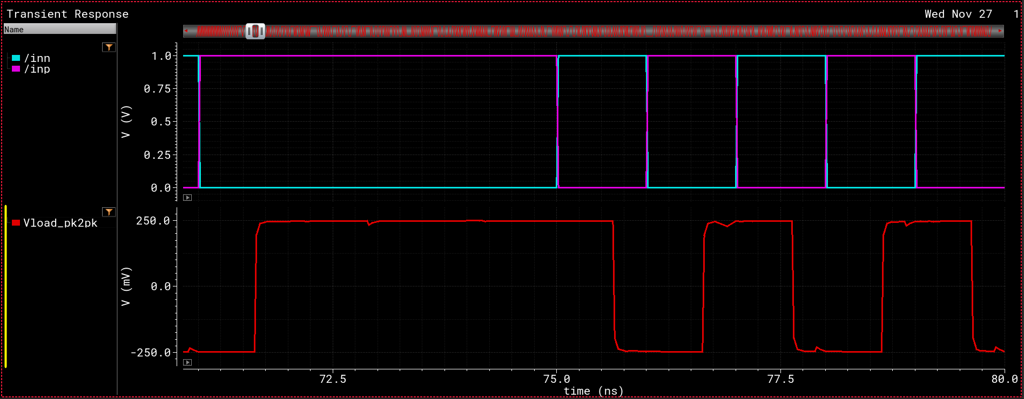
Waveforms
+250 mV
VSWING(PK2PK) = 500 mV
–250 mV

Slide 14
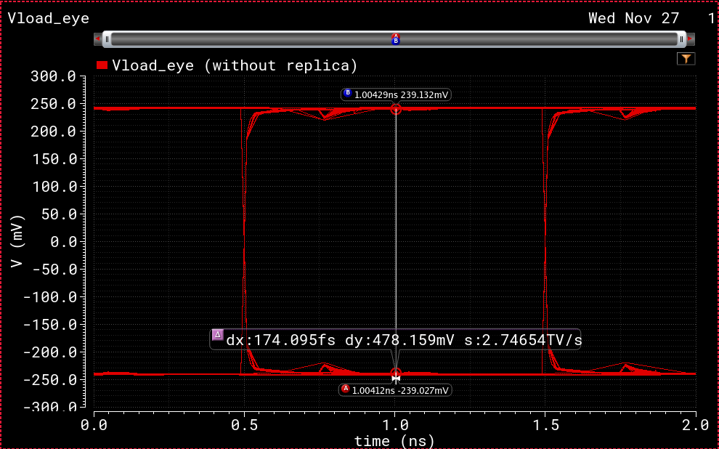
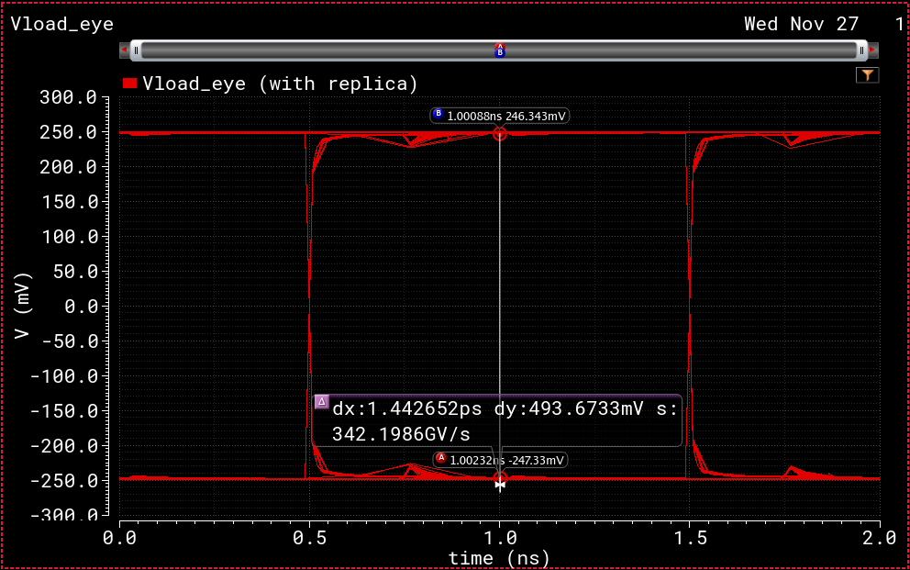
Waveforms (Eye-Diagrams)
No Replica:
VSW(pk2pk) = 478.16 mV
With Replica:
VSW(pk2pk) = 493.67 mV
➔ More Accurate Swing, at the expense of additional power drawn by an extra branch & the OpAmps
(For more info on how to measure Eye Diagrams)

Slide 15
Current Consumption
Total current drawn = 5 mA
(2.5 mA from main driver + 2.5 mA from Replica branch) (OpAmps not included)

